Slide 1
Forecasting Company Insolvency
Group
Anjali Haryani
Payal Chavan

Slide 2

Agenda
Project Overview
Problem Definition
Data Preparation & EDA
Feature Selection & Extraction
Model Building
Innovative Approach
Performance Evaluation
Prediction Result & Best Model
Project Management
Challenges Faced
Future Work

Slide 3

Project Overview
In a market economy, businesses can go bankrupt or start up naturally. Accurately determining if a company is facing bankruptcy helps reduce financial risks and improve economic outcomes.
The main aim of this project is to use various machine learning methods to determine if a company, based on its financial indicators, has gone bankrupt. (This is a classification problem)

Slide 4
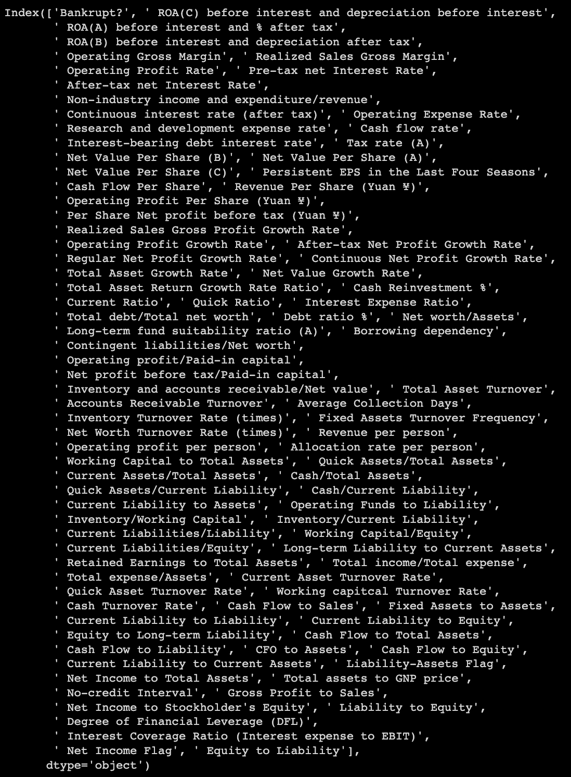
Problem Definition
Identify factors contributing to corporate bankruptcy.
Analyze correlations among provided categories.
Utilize SMOTE to address data imbalance.
Employ various machine learning techniques for modeling and evaluation to determine optimal model.
Data Source & Description
The dataset comprises 6819 entries and 96 columns, with 95 columns serving as predictors and one column designated as the target variable, labeled 'Bankrupt?'. Among the predictor columns, 93 are decimal, 2 are integer, and one is boolean.

Slide 5
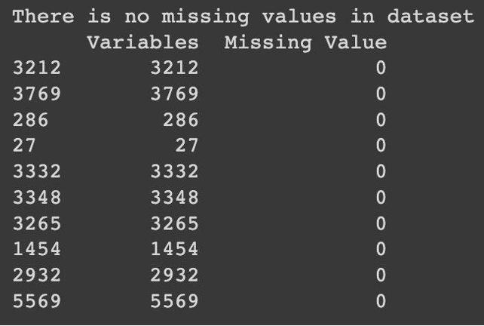
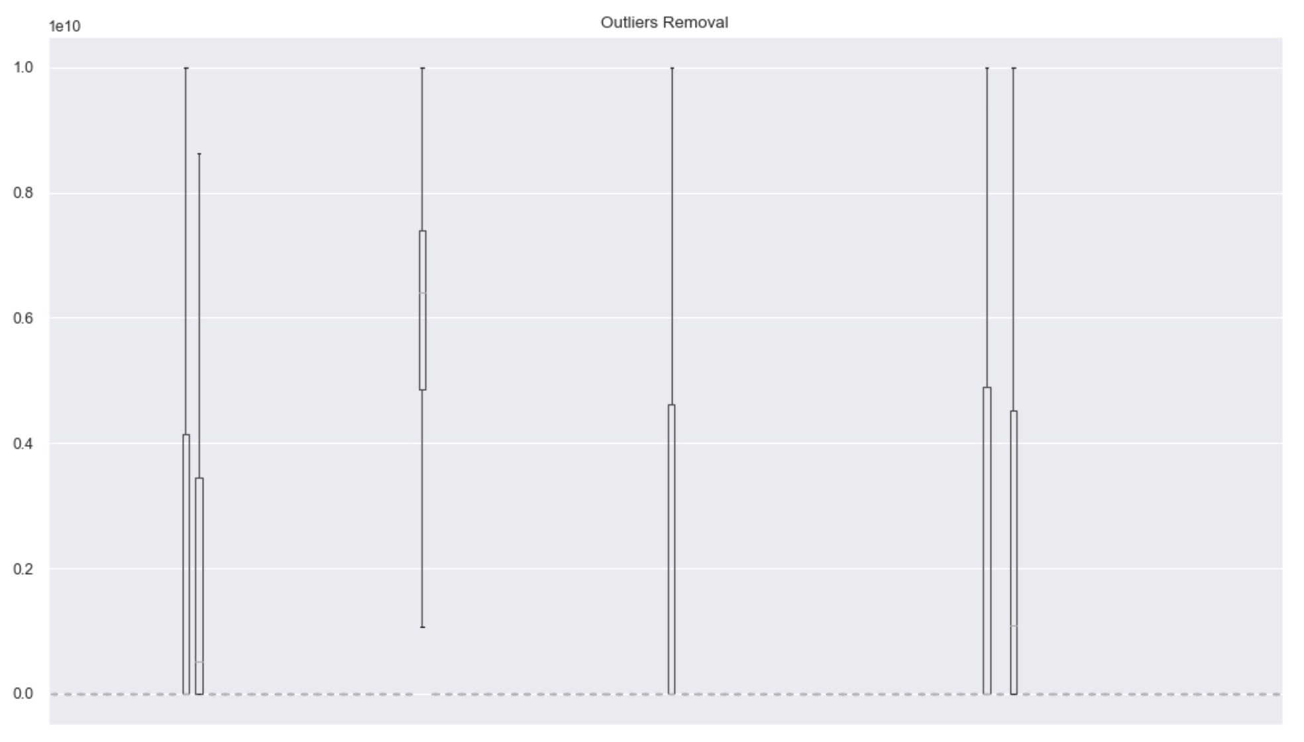
Data Preparation & EDA
Missing Value & Outlier Removal
The data is clean and there are no missing values.
Handling Outliers Larger Than 75th Percentile by replacing with upper quartile
Handling Outliers Smaller Than 25th Percentile by replacing with lower quartile.

Slide 6
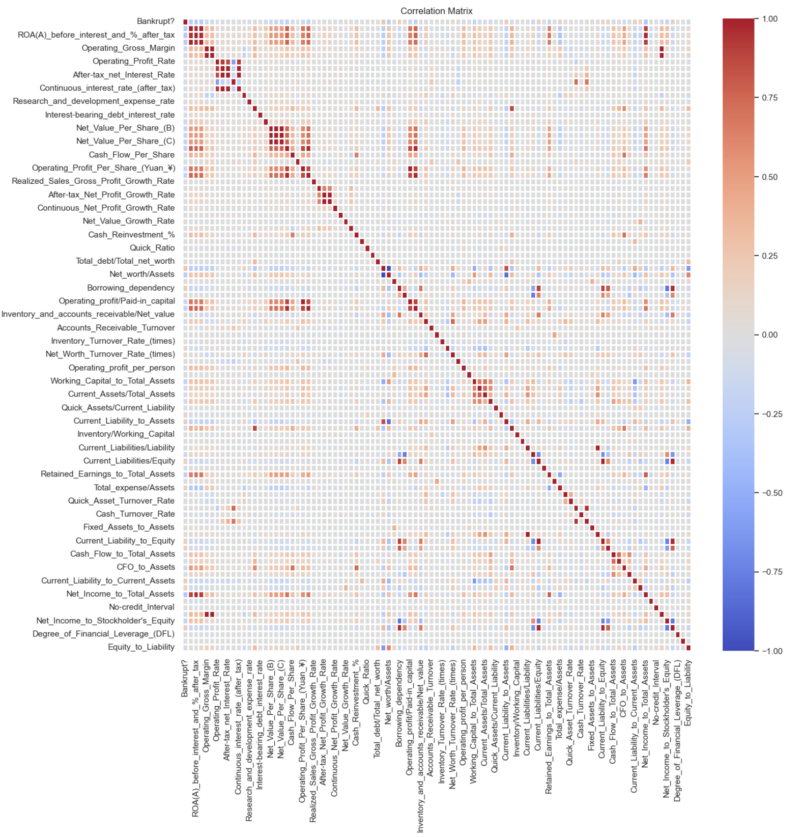
Data Preparation & EDA
Correlation/ Heatmap
The correlation between Operating Gross Margin and Realized Sales Gross Margin is the highest, around 0.99.
The correlation between Operating Profit Per Share & Operating profit/Paid-in capital is the second, around 0.99.

Slide 7
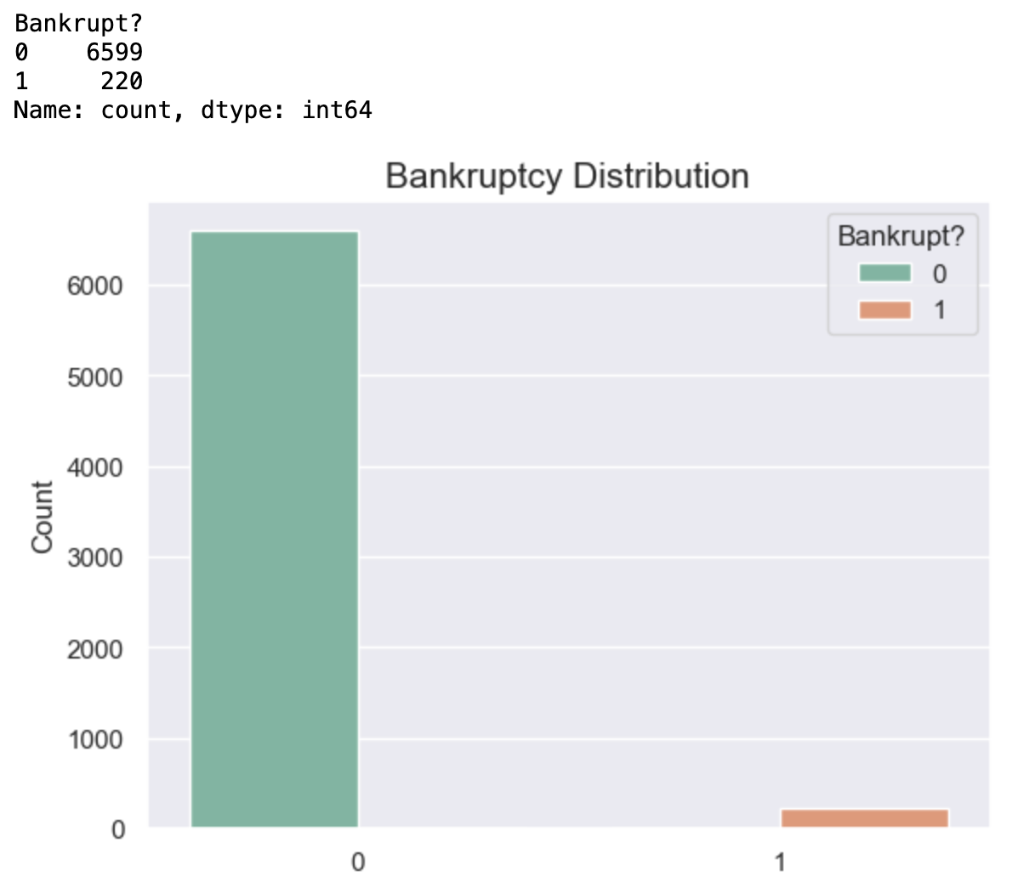
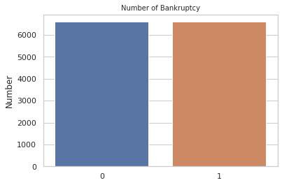
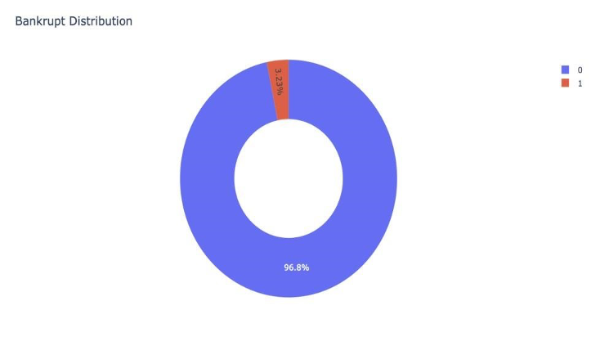
Data Preparation & EDA
Data Imbalance
SMOTE
Imbalanced Data
Balanced Data

Slide 8
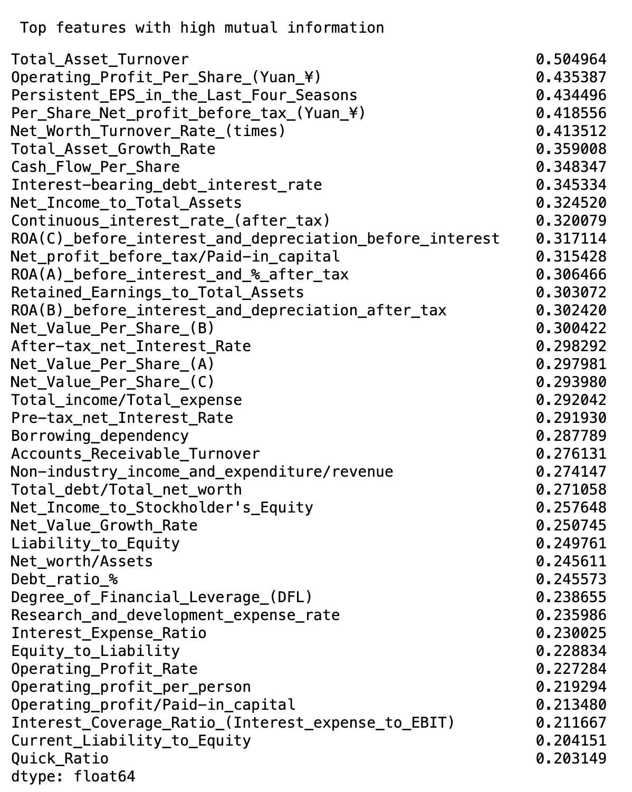
Feature Selection & Extraction
Feature Selection & Extraction
There were a lot of features in dataset. Since most features were uncorrelated with each other but there are also some of them correlated. Hence, we need to reduce dimension.
Feature Selection (PCA)
Feature Extraction (Select K Best & Mutual Info Classifier)

Slide 9
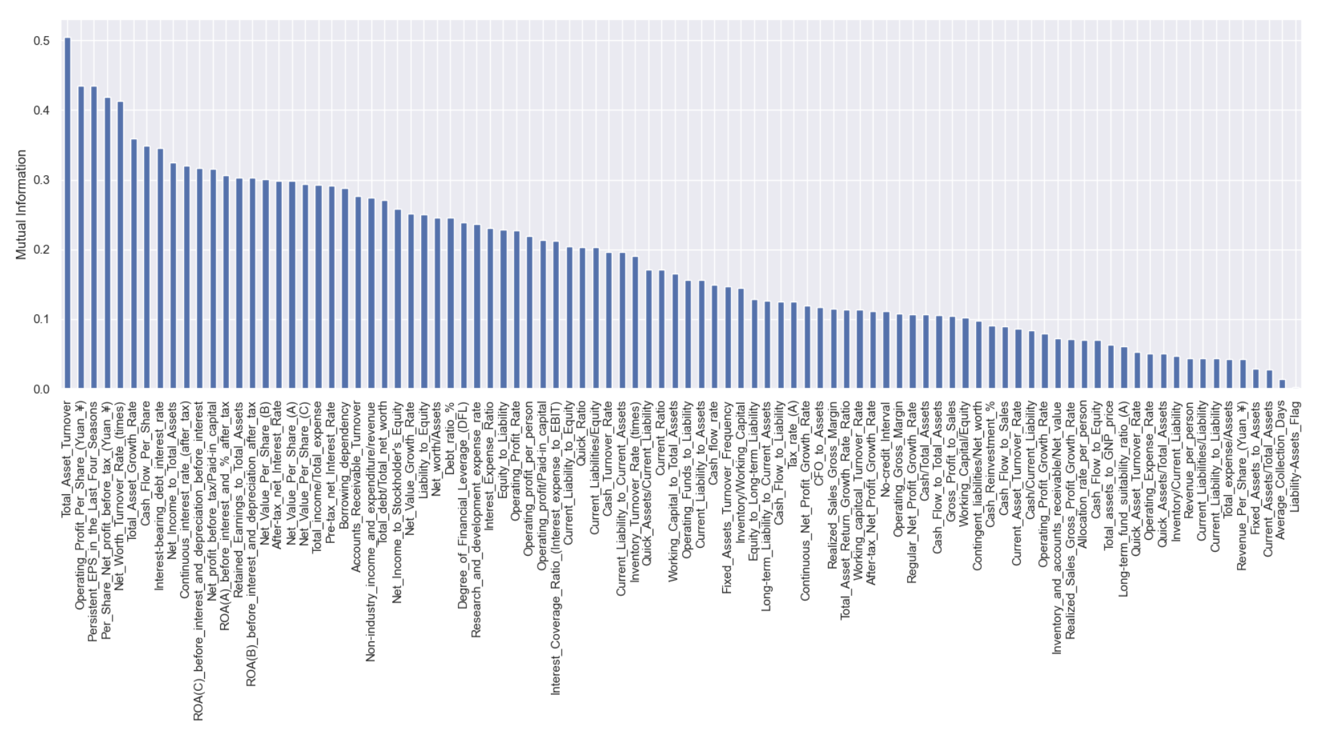
Feature Selection & Extraction
Feature Extraction
Best Method: Mutual Info Classifier
Left are features with higher mutual information values.
Right are features with almost zero mutual information values
We selected top 10 features

Slide 10
Model Building
Data Mining Model
We split the data set into a 75% training set and a 25% test set.
The following models were used for Classification
Logistic Regression Model
KNN Model
Decision Tree Model
Random Forest Model
SVM Model
XGBoost Model
Naive Bayes Model

Slide 11
Innovative Approach
Innovation in Models
To optimize model performance, we used some methods:
Cross Validation Technique (Resampling Technique)
KFold Cross-Validation
StratifiedKFold Cross-Validation
Hyperparameter Tuning Technique (Tweaking Model Parameters)
GridSearchCV
RandomizedSearchCV

Slide 12
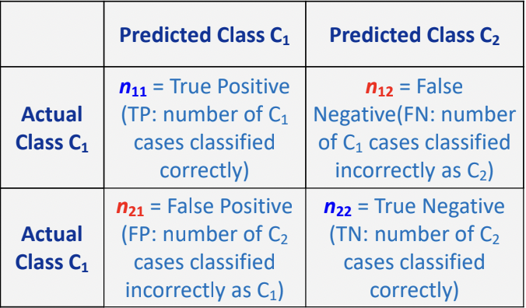
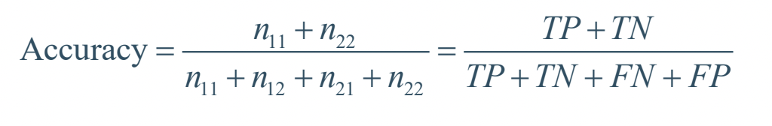
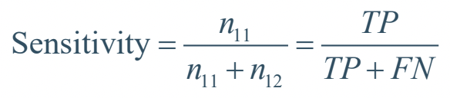
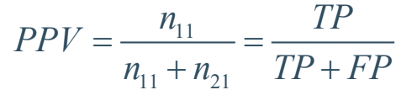
Performance Evaluation Factors
Confusion Matrix
Statistical Factor:
Accuracy
Precision
Recall(Sensitivity)
F1-score
Curve
ROC Curve
Precision-Recall Curve

Slide 13
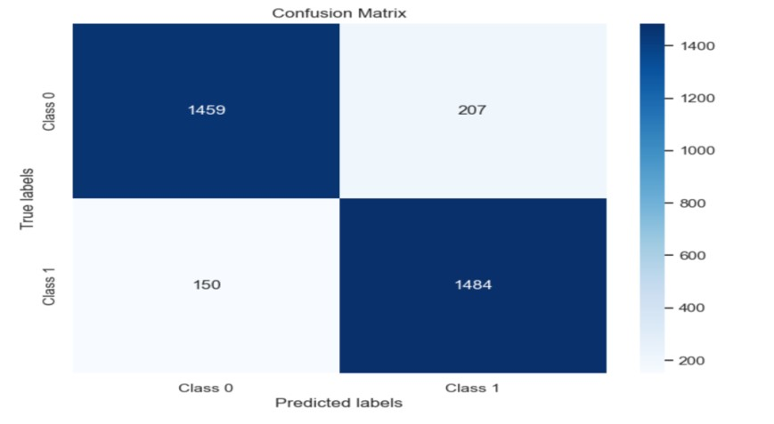
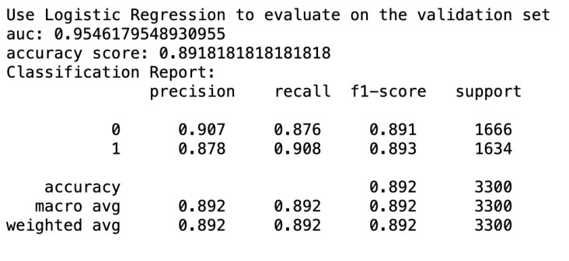
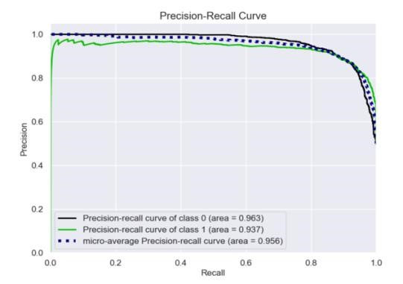
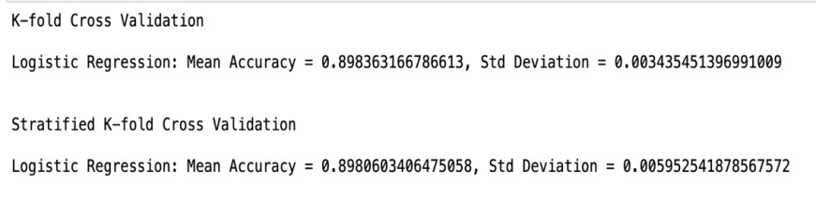
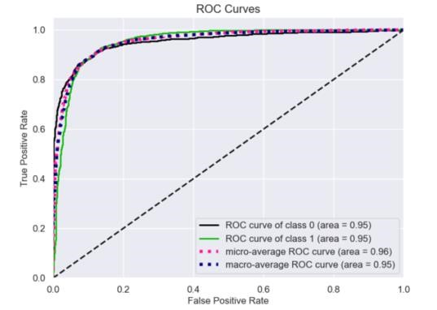
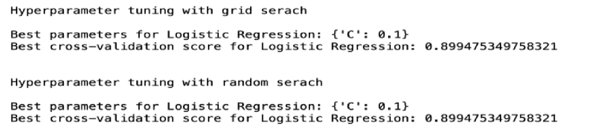
Performance Evaluation
Logistic Regression Model
Notes:
True Positive

Slide 14
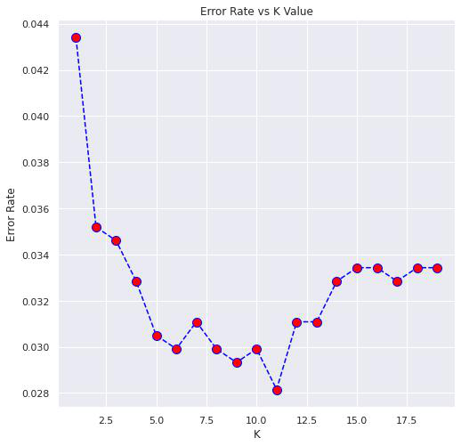
KNN Model
In KNN model, we calculated the model error depending on K from 1 to 20 and then chose the K=11, where the error dropped the lowest and k becomes the best K value.

Slide 15
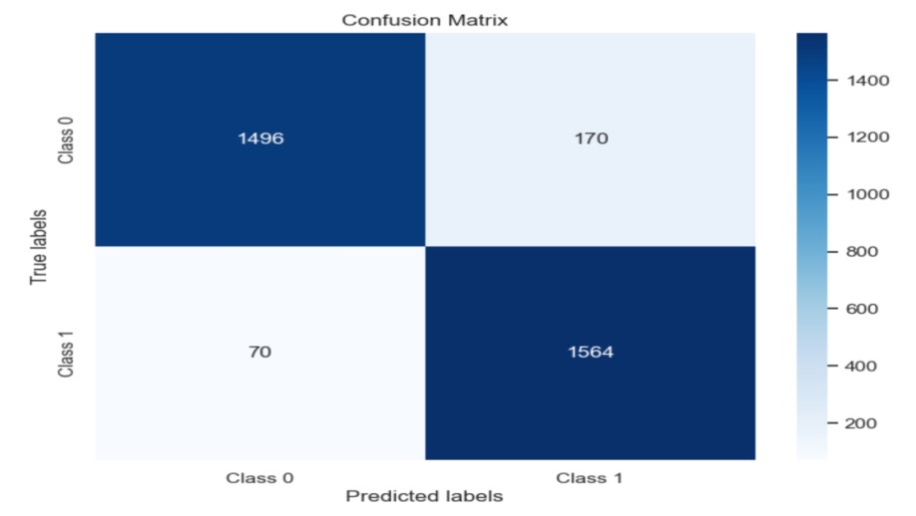
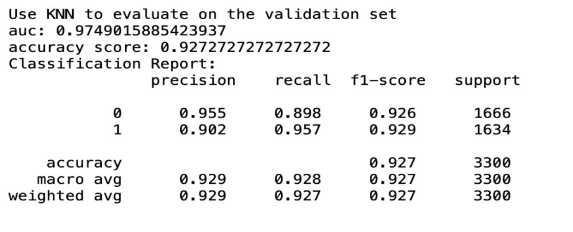
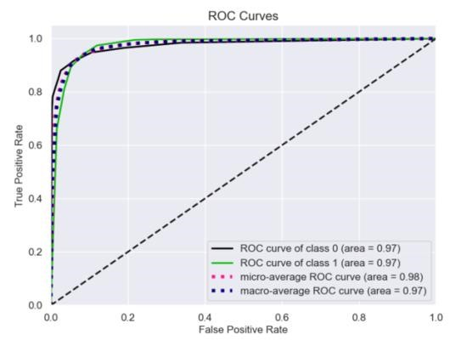
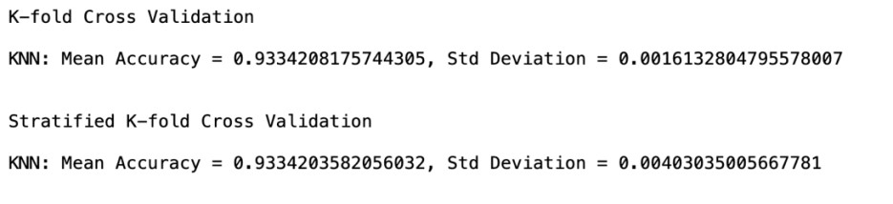
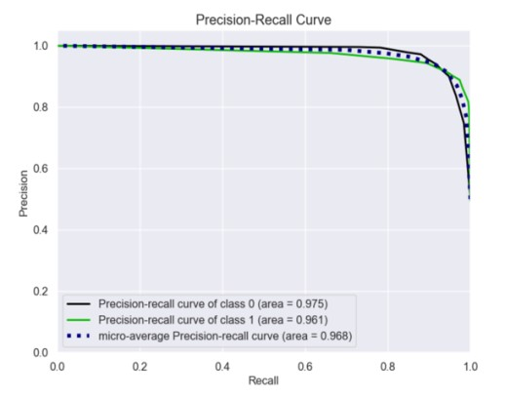
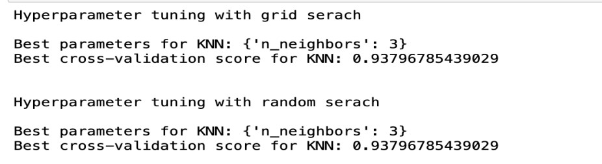
Performance Evaluation
KNN Model

Slide 16
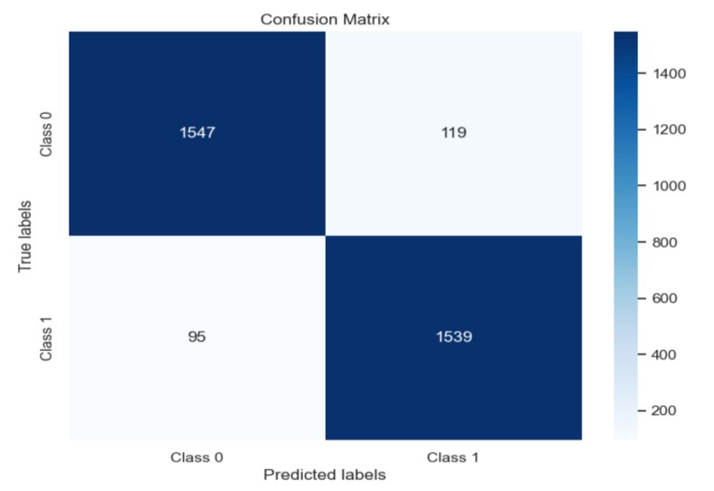
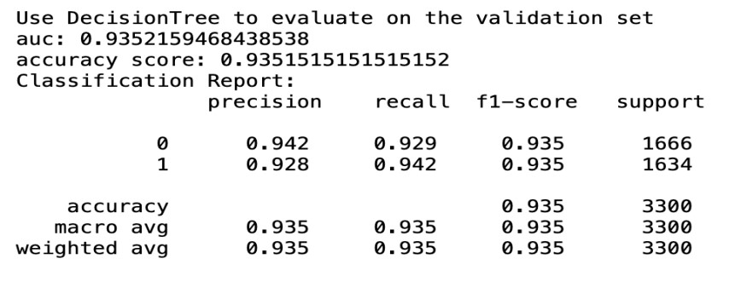
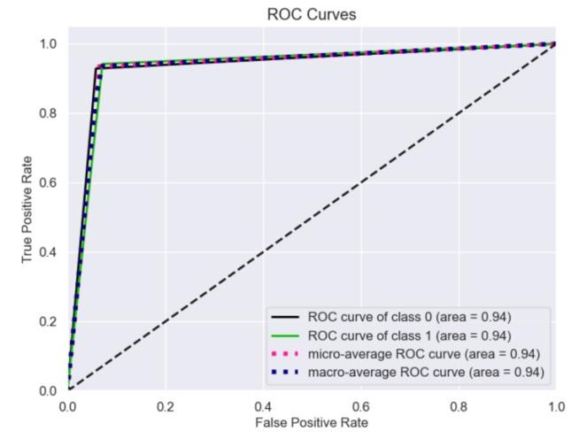
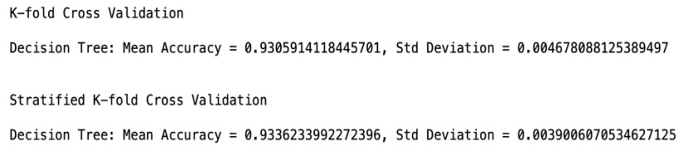
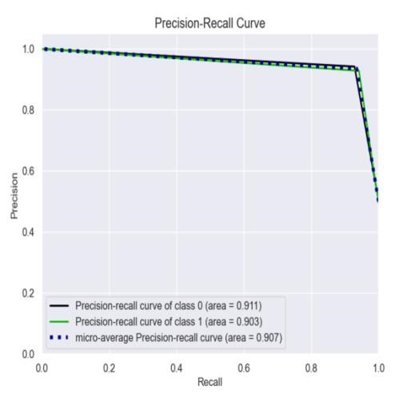
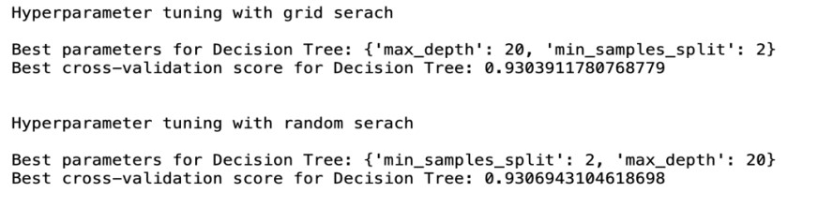
Performance Evaluation
Decision Tree Model

Slide 17
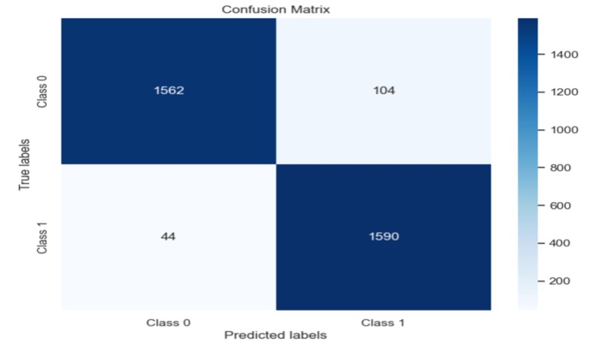
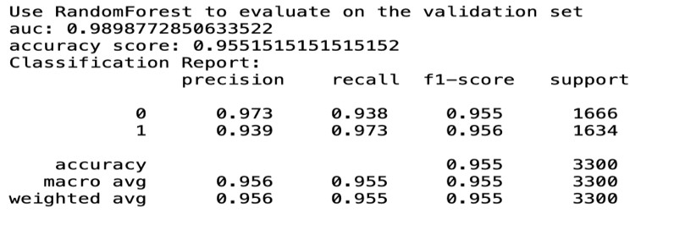
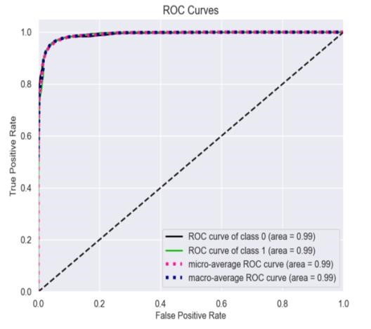
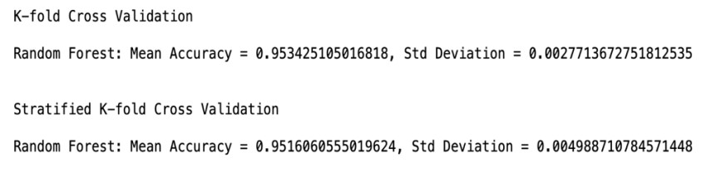
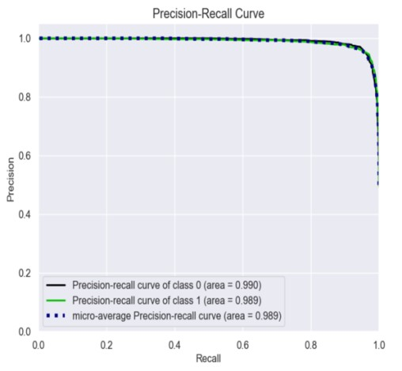
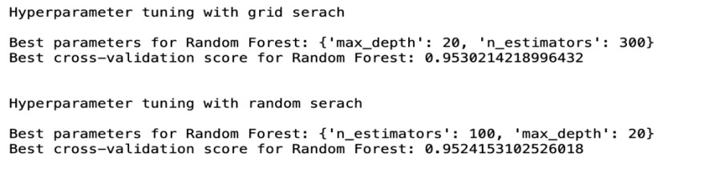
Performance Evaluation
Random Forest Model

Slide 18

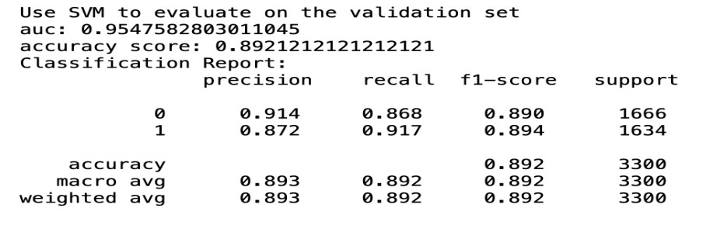
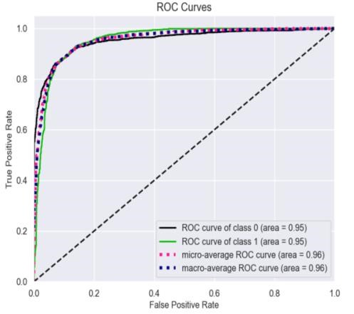
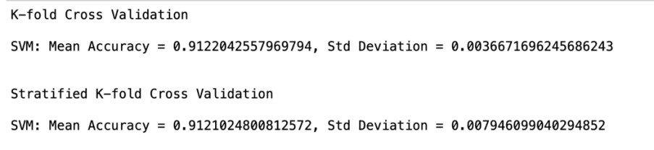
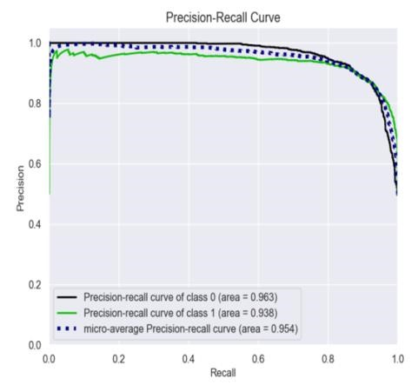
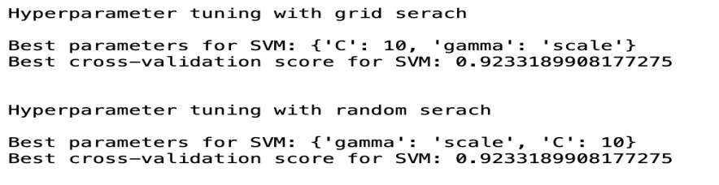
Performance Evaluation
SVM Model

Slide 19
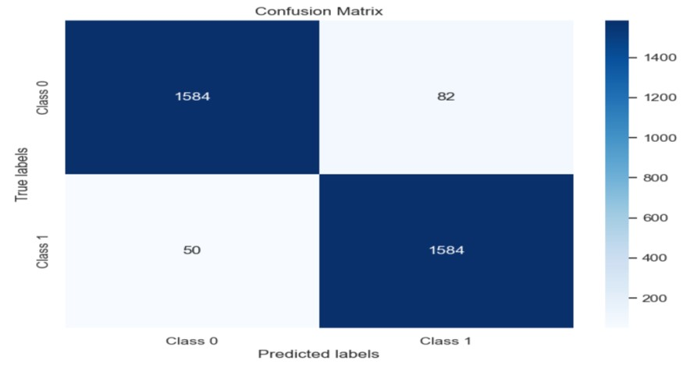
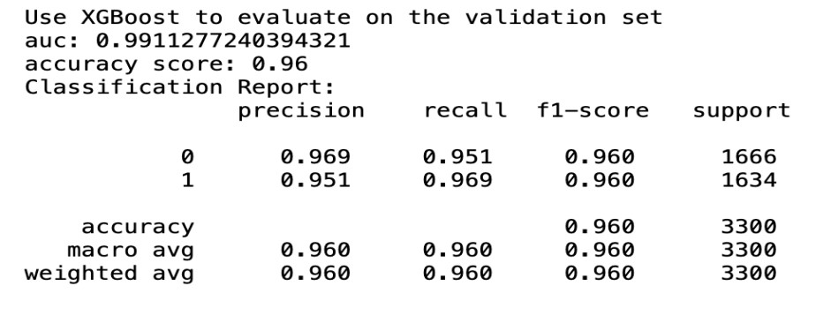
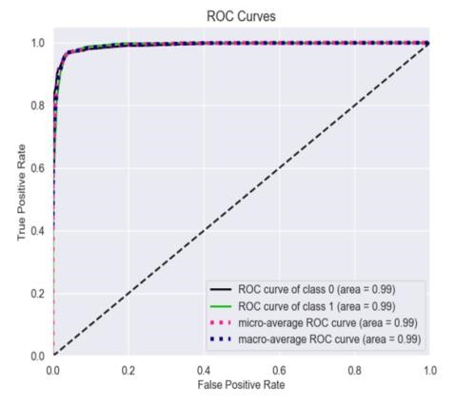
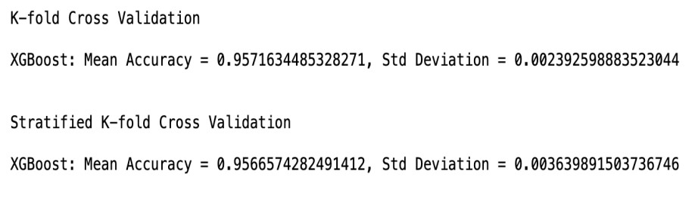
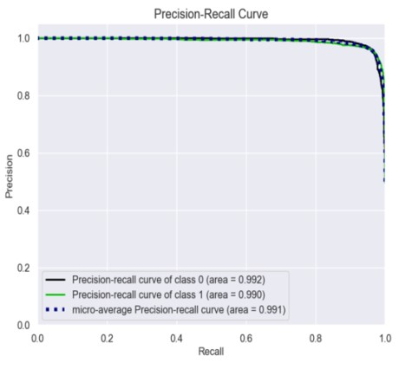
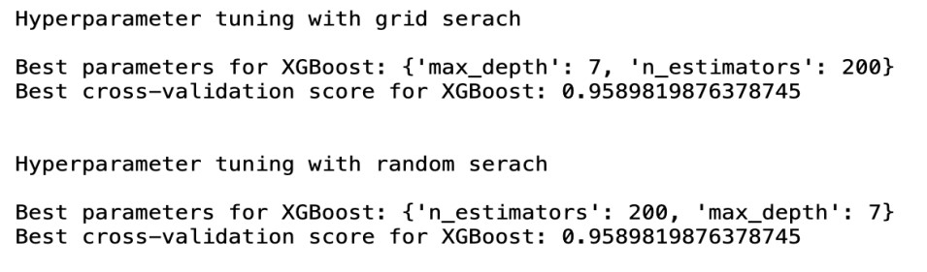
Performance Evaluation
XGBoost Model

Slide 20
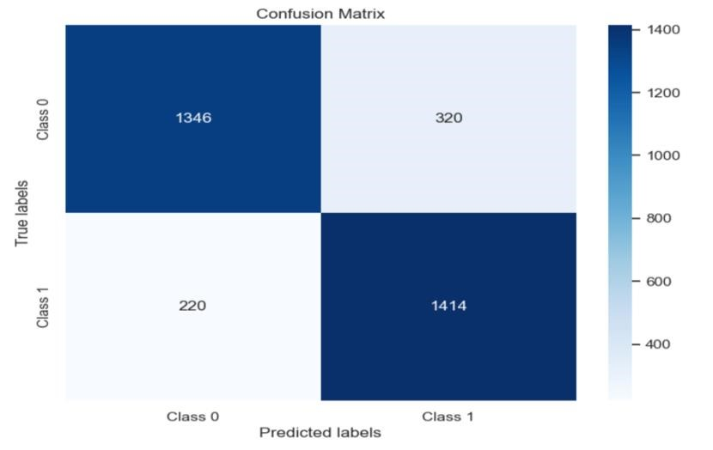





Performance Evaluation
Naive Bayes Model

Slide 21
Prediction Result & Best Model
Prediction Result
Model | Recall | Accuracy | Precision | ROC AUC | F1-Score
Logistic Regression | 0.876 | 0.891 | 0.907 | 0.954 | 0.891
Random Forest | 0.938 | 0.955 | 0.973 | 0.989 | 0.955
Decision Tree | 0.929 | 0.935 | 0.942 | 0.935 | 0.935
KNN | 0.898 | 0.927 | 0.955 | 0.974 | 0.926
SVM | 0.868 | 0.892 | 0.914 | 0.954 | 0.890
XGBoost | 0.951 | 0.960 | 0.969 | 0.991 | 0.960
Naïve Bayes | 0.808 | 0.836 | 0.860 | 0.914 | 0.833
Best Model
Our final result determined that the best prediction model for our dataset would be the XGBoost Model.

Slide 22
Project Management
Project Stage | Dates
Project Initiation | February 01, 2024
Information Gathering | February 03, 2024
Project Planning | February 08, 2024
EDA & Feature Engineering Phase | February 20, 2024
Model Implementation Phase | March 22, 2024
Model Evaluation Phase | March 25, 2024
Conclusion | April 01, 2024
Project Presentation | April 10, 2024

Slide 23


Outliers
Challenges
Time Consumption
Given the intricate nature of the data, precisely defining outliers becomes challenging.
Computational time required for KNN and SVM optimization is higher than expected.
Dimension Reduction
Finding Best Model
The PCA results did not meet our expectations. Consequently,we decided to utilize the MutualInfoClassif() method for feature extraction as an alternative approach to achieve dimensionality reduction.
Given the closely matched evaluation metrics, we are facing some difficulty in determining the optimal model that best suits our data.

Slide 24
Future Improvements
Temporal Features: Incorporating time-related aspects, such as trends, seasonality, in financial indicators over time.
Ensemble Methods: Combining various models (like random forests or gradient boosting) for predictions.
Model Explainability: Use techniques like SHAP or LIME to understand feature importance.
Industry-Specific Data: Gather industry-specific data relevant to the companies being analyzed.

Slide 25
Thank you for your time! Any Questions?

